Slide 1


Voucher Management System
(VMS)

Slide 2

Introduction
Discussing the voucher management system (VMS) with key stakeholders,
The Marketing Team
Product Development Team
IT Department
ERP
CRM
1

Slide 3
Project Overview
The existing manual process for Voucher Management
Implementing
Automated voucher management system
Integrated with other SLT systems
3

Slide 4
Main Features
Voucher Generation - Automated generation of unique voucher codes.
Voucher Redemption - Easy and secure voucher redemption process.
User Management - Role based access control for different stakeholders.
Reporting and Analytics - Comprehensive reports on voucher usage and redemption.
Notification System - via SMS and email.
Integration with Existing Systems - Seamless integration with ERP systems.
4

Slide 5
Benefits
Improved Efficiency & Accuracy- Reduces manual processing and human errors.
Enhanced Customer Experience - Simplifies the process of redeeming vouchers for customers.
Real-Time Insights - Provides real-time information on voucher usage.
Cost Savings - Minimizes operational costs associated with voucher distribution.
Security - Ensures secure handling and redemption of vouchers.

Slide 6
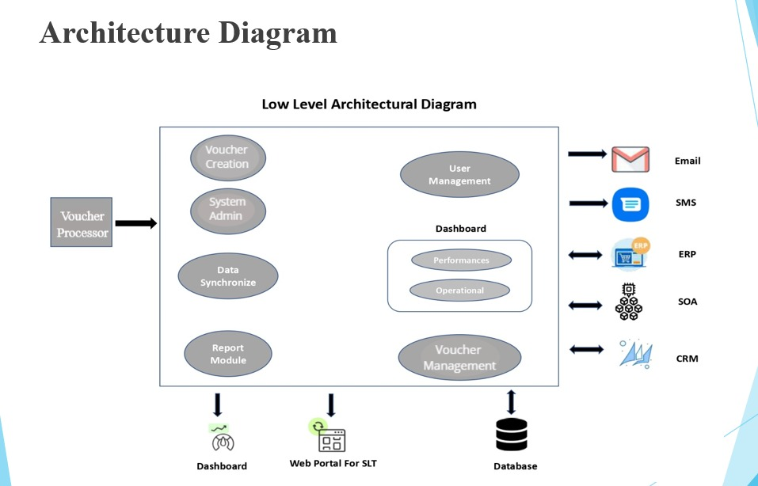
Technical Overview and Architecture
6

Slide 7
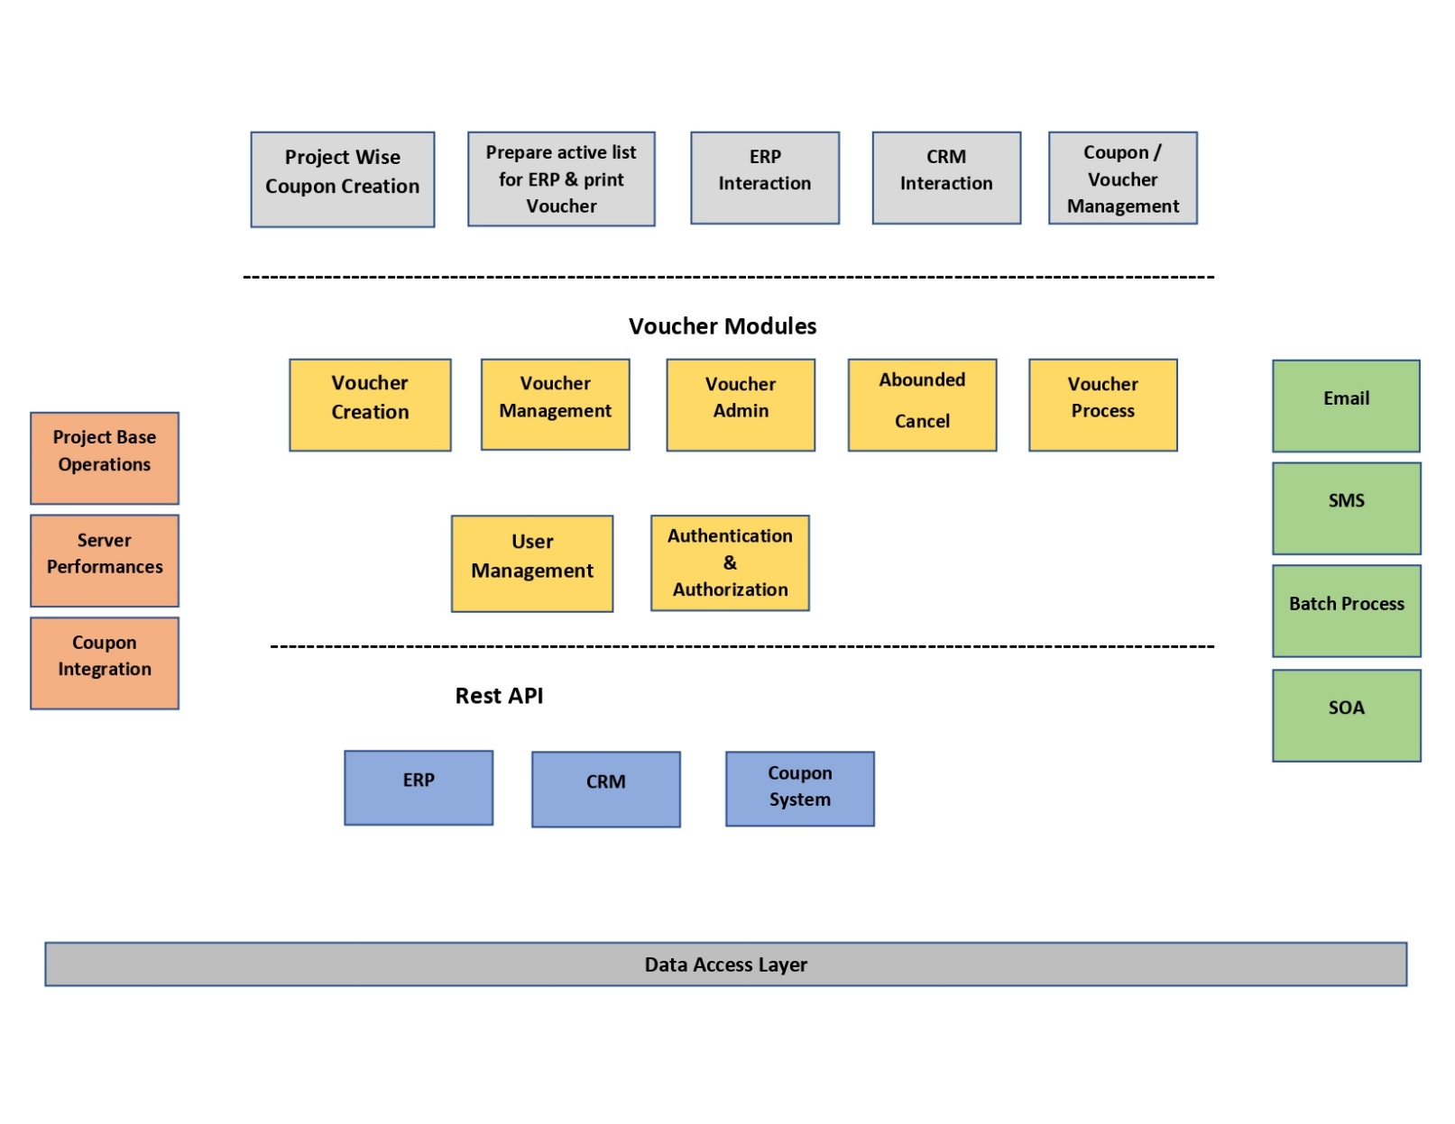
Technical Overview and Architecture
7

Slide 8
Technical Overview and Architecture
Technology Stack of VMS
Backend : PHP & Laravel
Frontend : Bootstrap, HTML, JavaScript
Database : MySQL
Authentication : JWT (JSON Web Tokens)
API Documentation : Swagger
Version Control : Bit Bucket
8

Slide 9
Current Status
.
Requirements gathered and analyzed.
System design and architecture of the system has been planned.
User Interfaces has been completed.
Reporting is in the discussion phase.
Initial testing and bug fixes has been done.
Test cases have been completed up to 60%.
Documentation is done up to 50%.
The front end (web pages) developing is in process.
9

Slide 10
Bottlenecks
Integration information is lagging ( ERP, Cashier)
Need for a Server
Reports are not finalized yet.
Need relevant APIs from ERP and CRM to do further development and implementation.
10

Slide 11
Q & A
11

